Slide 1

Cybersecurity in the Supply Chain
Thomas Runge thomas.runge@gratia-inc.com | +1 513-800-0660
March 7th, 2018

Slide 2
Cybersecurity in the Supply Chain
“A supply chain is a system of organizations, people, activities, information, and resources involved in moving a product or service from supplier to customers….”
Source: wikipedia.com

Slide 3
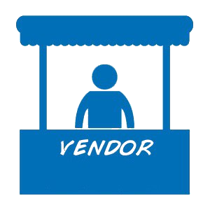
Cybersecurity in the Supply Chain
Part of the supply chain are All Vendors
Any JIT supplier with remote connectivity and/or physical access to facilities
External building control systems
External Alarm systems (Fire, Intrusion/Break in, Camera surveillance)
Machine control systems (that are being maintained and programmed from the outside)
Any IT equipment with “call home” functionality and (potentially) remote access (e.g. storage area networks, phone systems)

Slide 4
Cybersecurity in the Supply Chain
“Vendor Management”
What’s so important with vendors?
      Shared data access
      Direct/remote connectivity into internal network
      No or very limited control over their endpoints
      Shared data (e.g. IP regarding manufacturing processes, on IT consulting side network diagrams)
      Business dependence on their supplies / service delivery

Slide 5

Cybersecurity in the Supply Chain
Vendor Management over time - 1970s
“Make sure there is a big contract signing party and Christmas gifts sent to me.
We can pay that price as long as I get my cut.”

Slide 6

Cybersecurity in the Supply Chain
Vendor Management over time - 1980s
“Make sure the Christmas gifts from you are bigger than from your competitors.
Oh, and send the gifts to my home address”

Slide 7

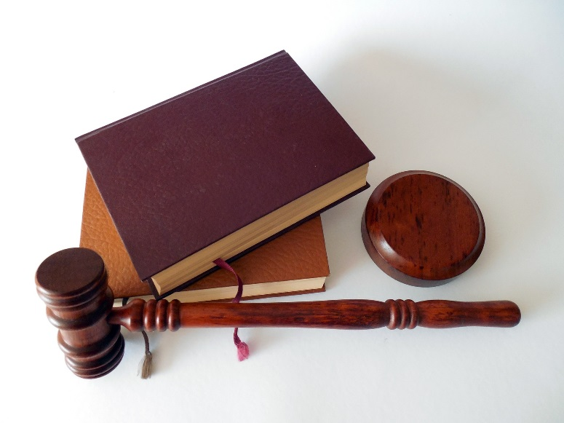


Cybersecurity in the Supply Chain
Vendor Management over time - 1990s
  “Gifts are nice, but we need some contractual language that you will always be able to deliver your products when we order them.”
Introduction of Just In Time Warehousing and connectivity through the Internet…

Slide 8



Cybersecurity in the Supply Chain
Around 1995
“Cannot officially take your gifts anymore, drop them off in person at night at a parking lot on the interstate. And if you fail to deliver your products and our complete production comes to a halt, you will be out of business and we will come to pick up your first born as you agreed to in our contracts.”
X

Slide 9
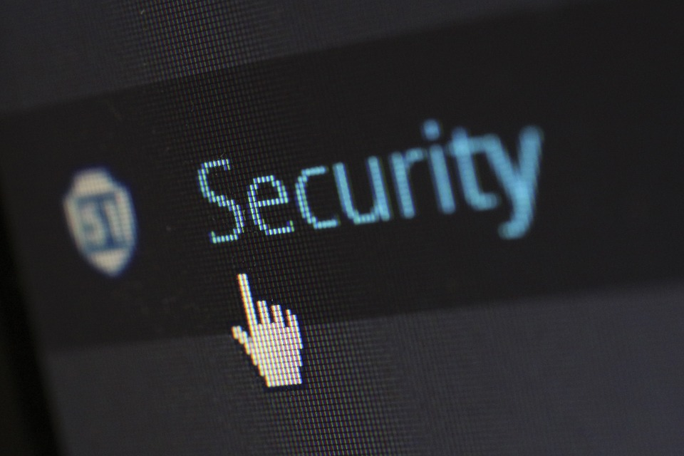
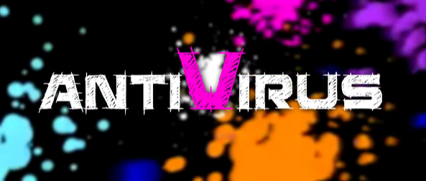
Cybersecurity in the Supply Chain
Around 2005
“Before you third party vendors connect to our network, our IT department will scan your notebook and make sure a valid antivirus software is installed.”

Slide 10

Cybersecurity in the Supply Chain
Around 2005
“Before you third party vendors connect to our network, our IT department will scan your notebook and make sure a valid antivirus software is installed.”
… and I still want the card
‘Happy Holidays, we donated…’

Slide 11

Cybersecurity in the Supply Chain
Around 2010
“You will monitor how we use your products and automatically restock in our warehouse when needed. Yes, of course you can connect to our ERP / WMS solution.”

Slide 12
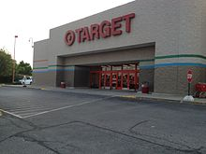
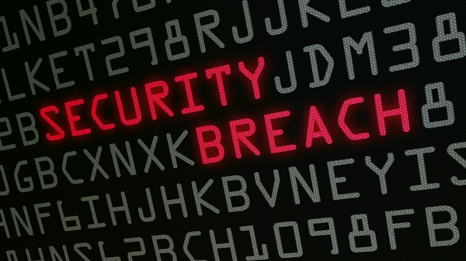
Cybersecurity in the Supply Chain
2013
“Oops, you guys did not secure your network and the bad guys broke into our system through the connection you use to monitor our product usage. We need to end this. Sign here that this will not happen again. Oh – and tell the Millions of our customers whose data got into the darknet that it was your fault.”
“… and yes, don’t worry too much – just pay for the identity theft monitoring service and we both will be fine.”

Slide 13
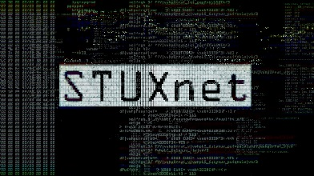
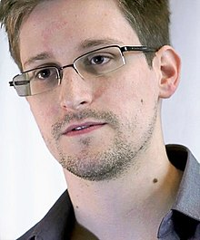
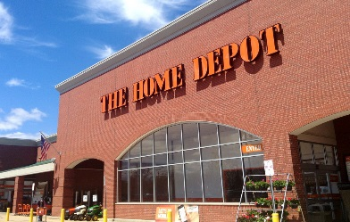
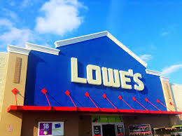



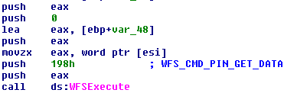
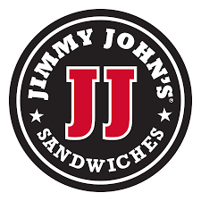

Cybersecurity in the Supply Chain
2010 - Stuxnet (primarily Iranian uranium factories)
2013 – Edward Snowden
2014 - Homedepot
2014 - Lowes
2013 – Target
2014 - GreenDispense (European ATMs)
2015 – AT&T
2015 – California State University
2015 – Jimmy John’s
2014 – Goodwill

Slide 14

Cybersecurity in the Supply Chain
2018
Vendor Management – The Next Generation
IT Security trickles down the supply chain
Many compliance areas already require monitoring and ensuring vendor compliance like
In February 2018, the Department of Homeland Security launched a supply chain cybersecurity initiative
SSAE 18 (1996) HIPAA (1996) /HITECH (2009) PCI-DSS (2004) | ITAR (1976) FDA (Title 21 CFR Part 11 – 2007) NIST 800-171 …. and others

Slide 15
Cybersecurity in the Supply Chain
2018
Vendor Management Evolution
Initially relationship driven
Then shift to legal and business requirements oriented
Now technology and cybersecurity added to business and legal requirements

Slide 16

Cybersecurity in the Supply Chain
Crystal ball
Securing the supply chain will be regulated and audited
  Current NIST 800-53/171 will take a big part in definition of requirements
  Starting with Large Enterprises for reasons of national security
  LEs passing it down to their vendors
  2023 it will be a standard like SSAE 18

Slide 17
Cybersecurity in the Supply Chain
Importance
-- Personal gain
-- Price
-- Compliance
-- Security Awareness
2018
Time
1970
1990

Slide 18
Cybersecurity in the Supply Chain
Implement / optimize vendor management
Four Easy and Important Steps
Initial assessment / homework
Establish Vendor Cybersecurity Framework
Implementation into vendor management program
On-going monitoring, management and continuous improvement

Slide 19
Cybersecurity in the Supply Chain
Step 1 – Initial Assessment
Homework
Obtain the organization’s current regulatory compliance requirements
SOX/SSAE 18, PCI-DSS, ITAR, HIPAA/HITECH, FDA, ISO 27001, NIST 800-53/171, GDPR etc.
Analyze where sensitive data is stored and how data flows between the company and all third parties and within the infrastructure
Discuss the program with business teams and executives to ensure full buy in from all sides!

Slide 20
Cybersecurity in the Supply Chain
Step 1 – Initial Assessment
Risk assessment
Determine what will happen if a vendor is not delivering or got breached and you need to stop their access to your systems and data.
Inability to provide product to you, halt of own production
May lose own regulatory compliance
Potential fines to be paid
Potential of supplier bankruptcy (lawsuits and/or losing customers)
Long term impact on product availability and own capability to fulfill warranty obligations
Loss of customer confidence, cancelled contracts, exposure due to breach of own agreements
Lawsuits/legal implications

Slide 21
Cybersecurity in the Supply Chain
Step 2 – Define Cybersecurity Framework
Vendor Cybersecurity Framework
Determine minimum acceptable cybersecurity measures on vendor side (Security audits, SIEM, Antivirus, reports provided to you)
Define data ownership and how that data can be used
Setup a communications and incident response plan
Define the security compliance auditing process
Outline contractual obligation in case of non-compliance (e.g. right to terminate)
Ensure vendor agreements reflect these requirements and vendor is aware of the overall vendor cybersecurity program as well as the consequences of non-compliance!
Integrate change management processes
Monitor
  vendor’s access to networks and data. Review data regularly.
  vendor’s endpoints patch levels, usage of SIEM, endpoint protection and antivirus solutions
Ensure the vendor has a data backup and DR plan in place

Slide 22
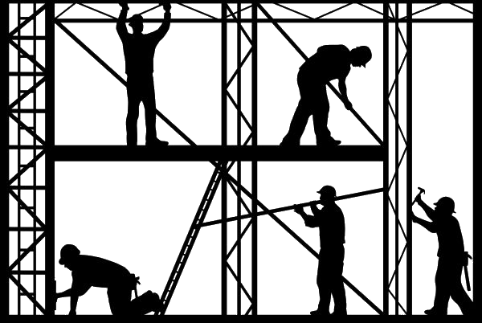
Cybersecurity in the Supply Chain
Step 2 – Define Cybersecurity Framework
Vendor Cybersecurity Framework
Require implementation and reporting regarding protective technologies
  Threat Intelligence solutions to catch propagating malware, unauthorized access, data exfiltration, unusual data traffic (volume, destination)
  CDR Content Disarm and Reconstruction (e.g. SAS Software)
  Endpoint monitoring (e.g. Event Tracker, Nessus, Palo Alto Traps)
  Endpoint patching (e.g. Saner)
  Active network traffic monitoring and AI/machine learning protection

Slide 23
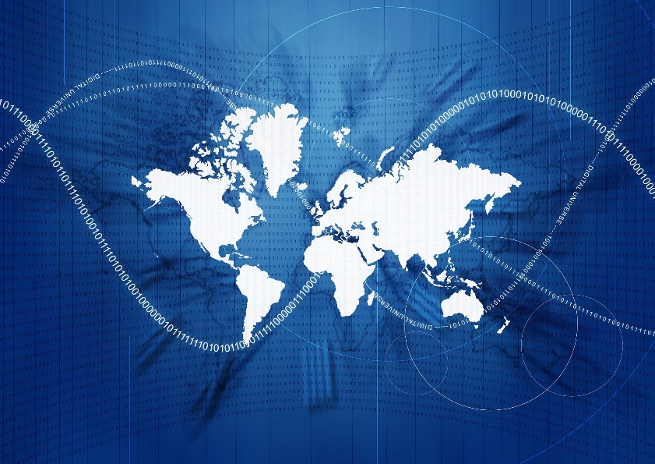
Cybersecurity in the Supply Chain
Step 3 – Implementation
Collaborate closely with vendor’s IT/Security teams
  Present framework, integration and execution
  Discuss latest threats specific to the industry
  Review continuous improvement measures
Regular reporting to internal and vendor’s executive/security teams
Perform regular audits as outlined in vendor management process

Slide 24
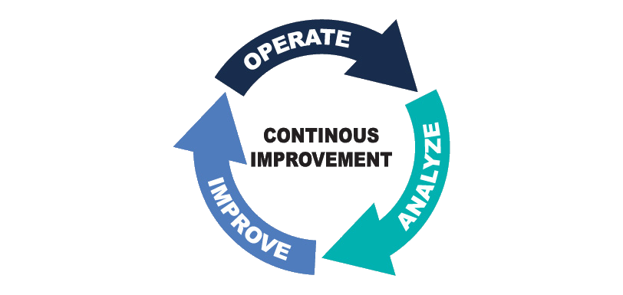
Cybersecurity in the Supply Chain
Step 4 – Continuous Improvements
Regularly review security/compliance requirements
Introduce new technologies as they evolve
Continue to present the value of the efforts to the
board and executive teams

Slide 25
Cybersecurity in the Supply Chain
Alternatively….

Slide 26

Cybersecurity in the Supply Chain

Slide 27
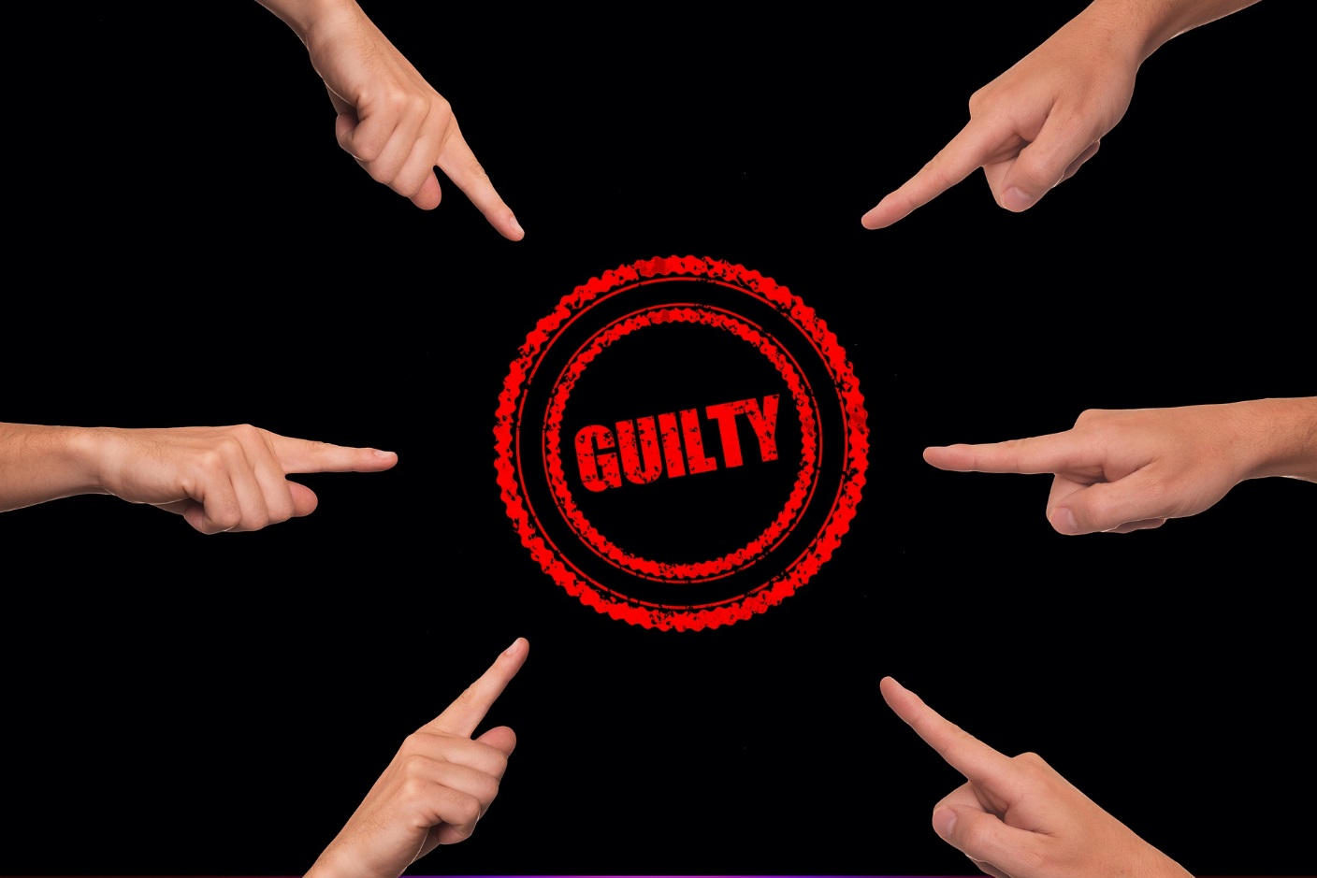
Cybersecurity in the Supply Chain

Slide 28

Cybersecurity in the Supply Chain

Slide 29

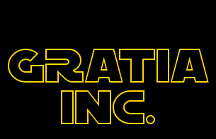

I know you all think about how the time of Christmas gifts can be brought back to life….
But be rest assured, that time is over for good, and so is the time of Superman out of the old comics.
But the good news is, Santa does not exist anyhow, and you have the great chance of being the next Superhero in your organization!
The current cyber threats put the jobs of all employees in an organization at risk, potentially even threaten the survival of the complete organization.
Don’t ask your vendors to implement
a security practice!
Tell them to!
… and may the Gratia team be with you!

